Slide 1
ISYE 4140 Statistical Analysis
Project #6 Classification
Thomas Cooperrider
Myles Adley
Sen Zhuang
Samantha Lamorte
In classifying the "bad" versus "normal" network intrusions, both the CART and random forest methods performed extremely well. In both cases, we witnessed a less than 1% error rate for data classification. Therefore, both the forest and single tree we created would be useful in real world network intrusion detection.

Slide 2
Preparing for Analysis
Omitted NA's
Generated good/bad variable
x[,43]ifelse(x$class=="normal", good, bad)
Randomized data
Took out irrelevant variables
Used both CART and Random Forest
Created training and test sets
Consulted with IT expert regarding relevant predictor variables
Notes:
generated good/bad variables --> this code pretty much just told R to recognize that there was less than 32 variables so it was able to run the code
irrelevant variables ---> which will be addressed in the next slide
training and test sets were used to validate the CART tree
IT expert is an owner of his own IT company --> told us variables that were significant and insignificant
NA's - missing variables
CART and RF to classify good vs bad variables

Slide 3
Search For Irrelevant Variables
Splitted the data into 4 subgroup
Added a randomly generated variable
Ran random forest and displayed variables importance plot
Took out variables with importance less than 12, which is the importance of randomly generated variable
12 Junk Variables:
land, urgent, num_failed_logins, root_shell, su_attempted, num_root, num_file_creations, num_shells,
num_access_files, num_outbound_cmds, is_host_login

Slide 4
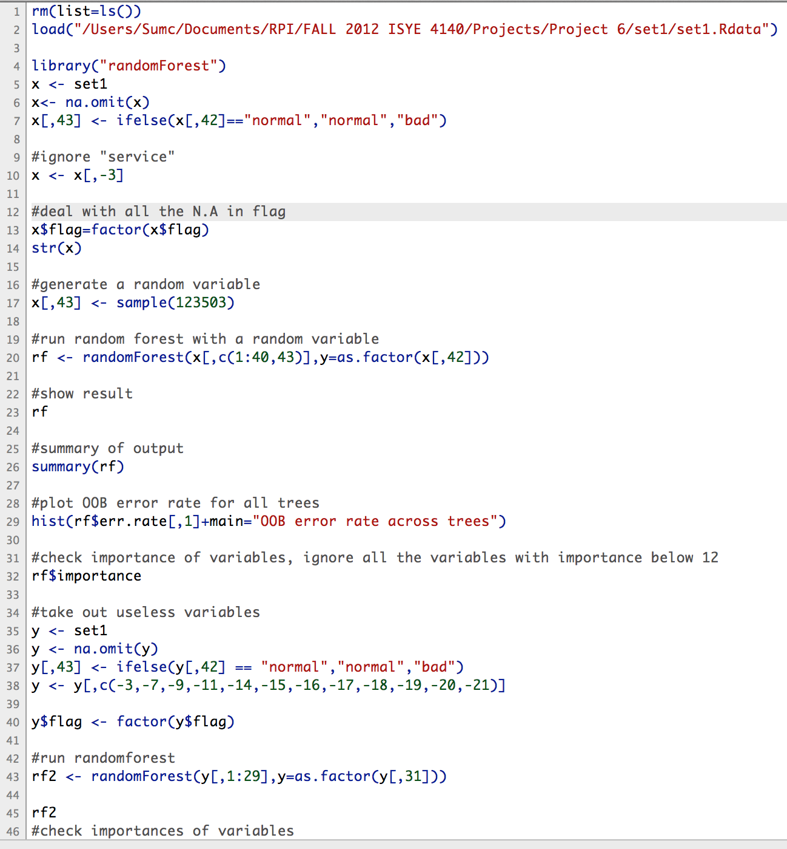
R Code
Notes:
this R code helped us figure out which variables were irrelevant or not
deal with problem with flag variable

Slide 5
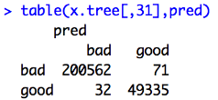
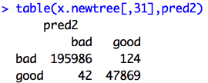
CART Analysis
Training Data Test Data
"Bad" Error Rate = 0.016%
"Good" Error Rate = 0.1437%
Specificity = 200562/(200562+32)
= 99.98%
Sensitivity = 49335/(49335+71)
= 99.86%
"Bad" Error Rate = 0.0214%
"Good" Error Rate = 0.2584%
Specificity = 195986/(195986+42)
= 99.98%
Sensitivity = 47869/(47869+124)
= 99.74%
Notes:
this shows the results of the CART tree analysis.. we created the tree using the training data and validated it using the test data.
Rsquare, SE
Rsquare=cor(pred.n,x.tree.n)^2 --> the squared value of the correlation between the predicted and actual values
SE=sqrt(sum((pred.n-x.tree.n)^2)/length(pred)) --> the square root of the sum of squared errors divided by n

Slide 6
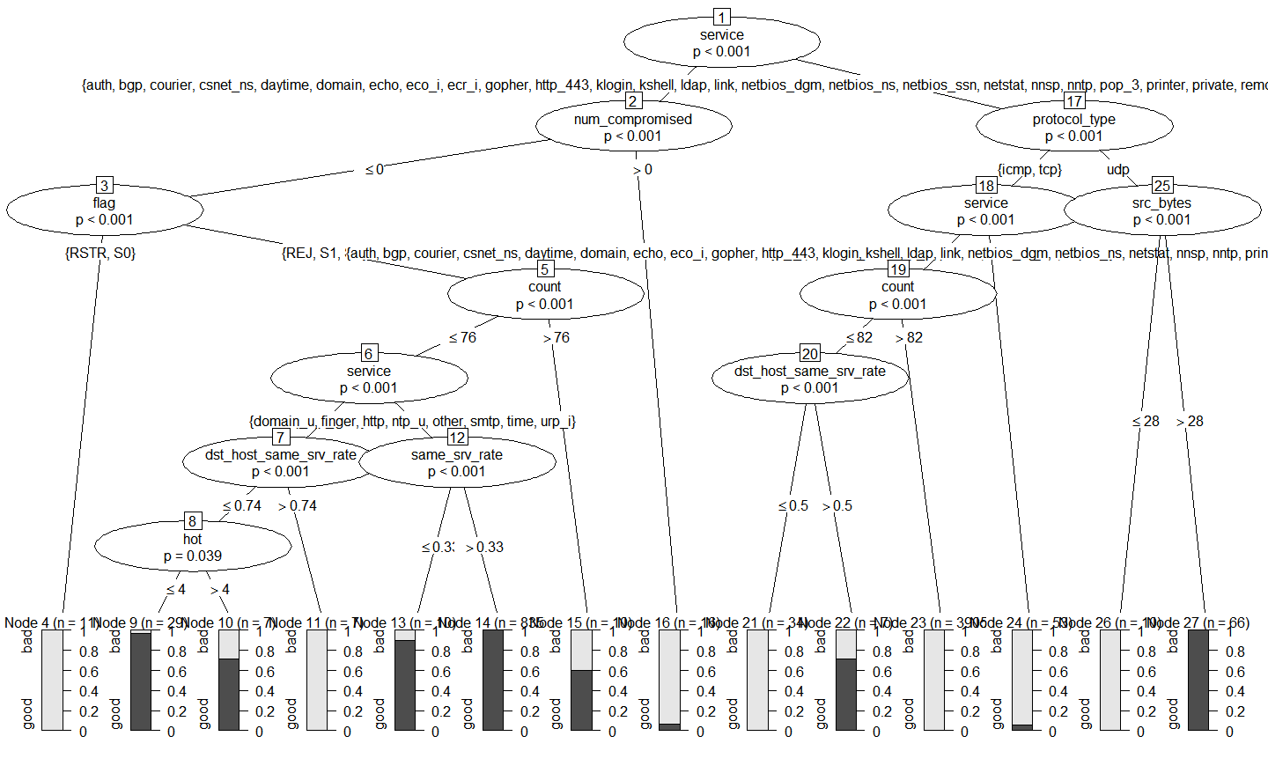
CART Plot
Notes:
the variables in the circle represent where the model chose to split the data.... you can that all of the variables are significant with p values less than 0.05. The bars represent the classification error rates.....
the bars with poor classification error rates have low n's and therefore did not have a large effect on our overall error rates

Slide 7
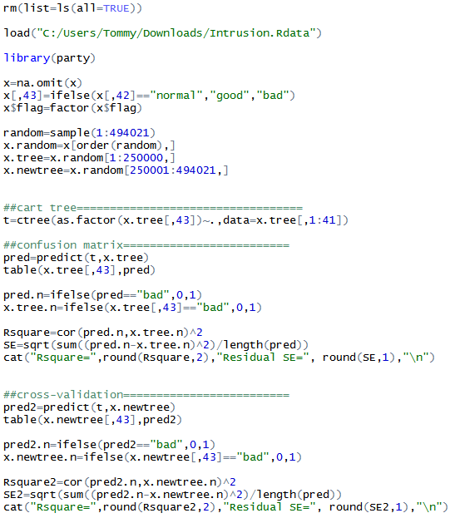
R Code
For CART
Notes:
we used the library party in order for R to handle more than 32 levels
this is how we outputted our analysis from a couple of slides ago
ctree handle more than 32 (levels) in a factor

Slide 8
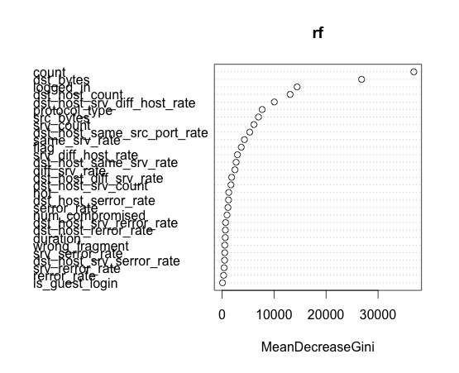
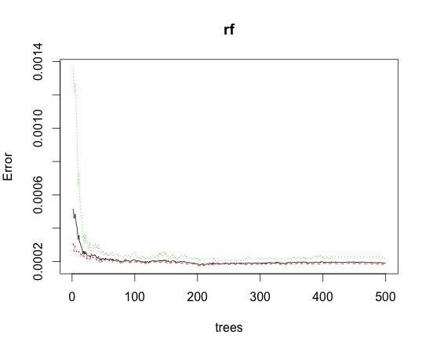
Imp Plot and Error vs. Trees Graphs
Random Forest
The first few variables are highly important.
Many useless variables at left bottom
The error rate becomes steady at around 190
Notes:
A large number of variables are useless(but not junk) with a few very important ones. That's why we tried to use the first few variables to run random forest in the next slide.
We dont need 500 trees. Using 200 trees instead can significantly decrease the time it takes to run random forest.

Slide 9
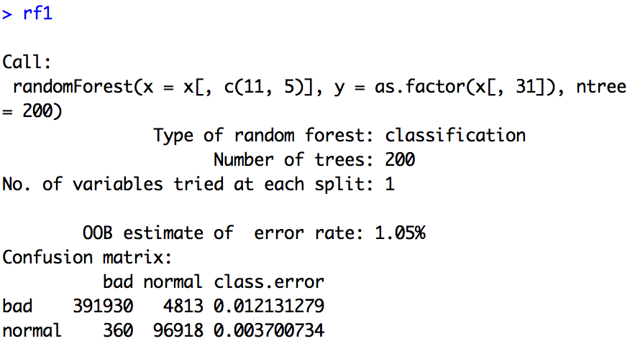
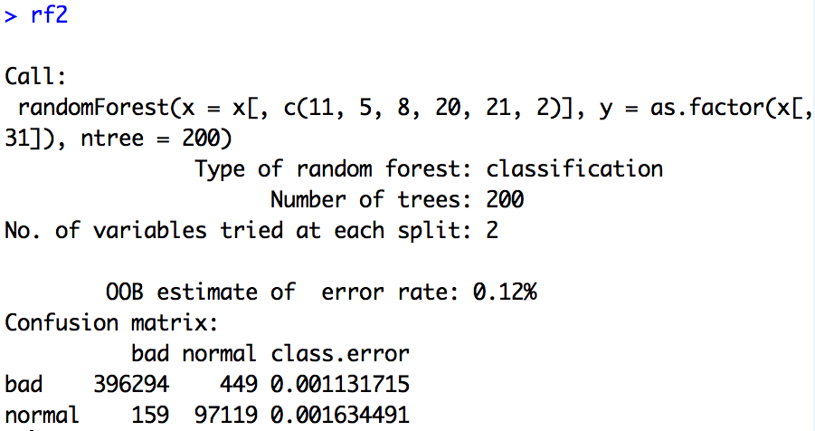
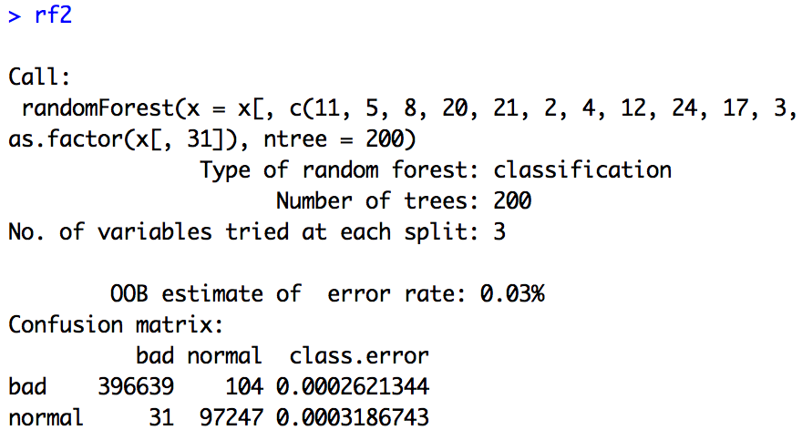
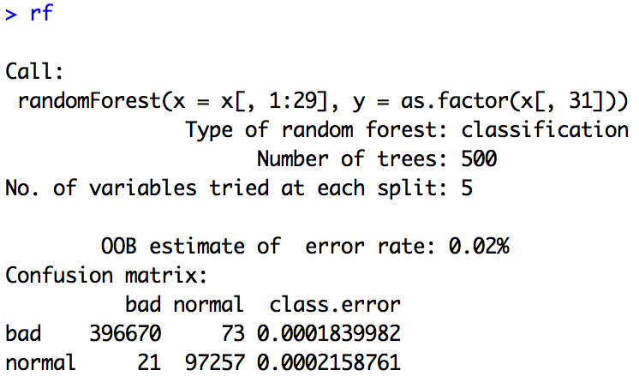
Random Forest Comparison
2 Variables
6 Variables
12 Variables
Without Insignificant Variables (32 Vs)
Notes:
Trade Off
Using fewer variables increases error rate, but simplifies and makes the model more efficient.(decrease the time it takes to detect)
Even the error rate is very small, errors are there. Sometime one error can cause a big problem in the company. We need to be aware of that.
How many variables that the randomForest uses will depend on cost and memory capability

Slide 10
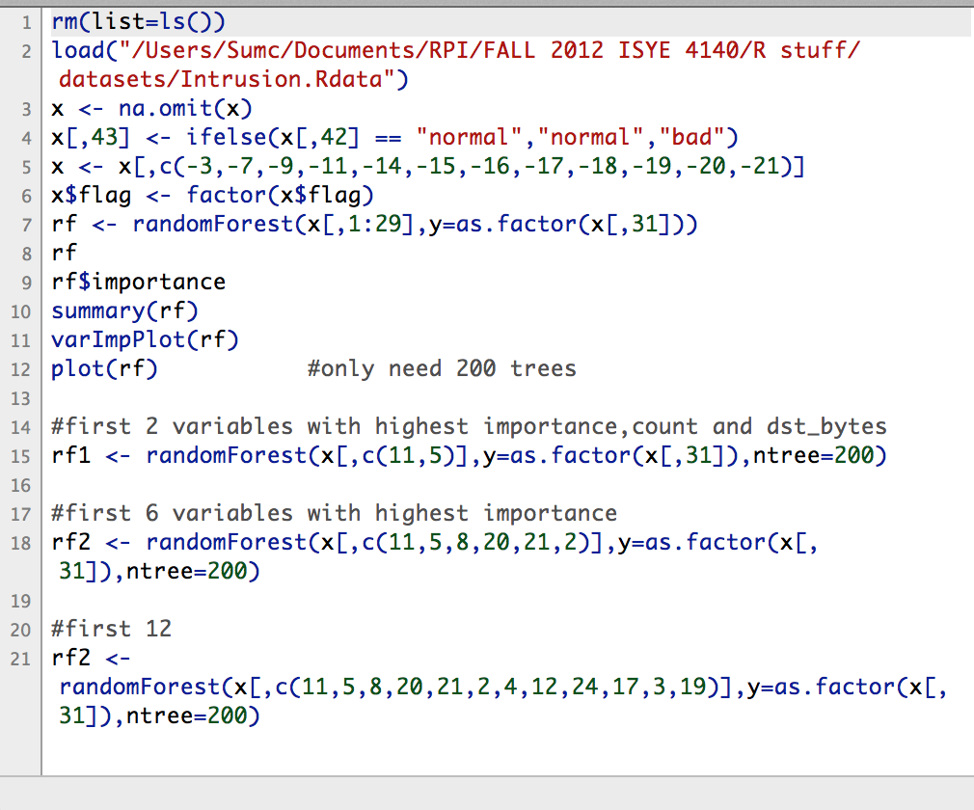
R Code

Slide 11

Questions?

